Slide 1
Monthly progress
EF5 team

Slide 2
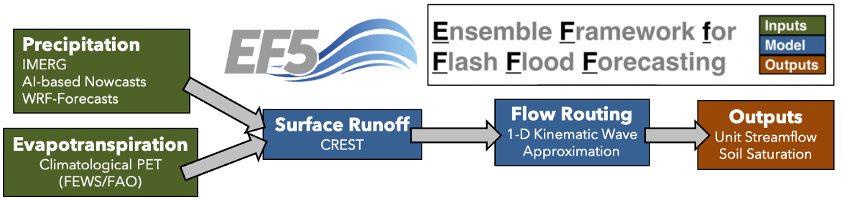
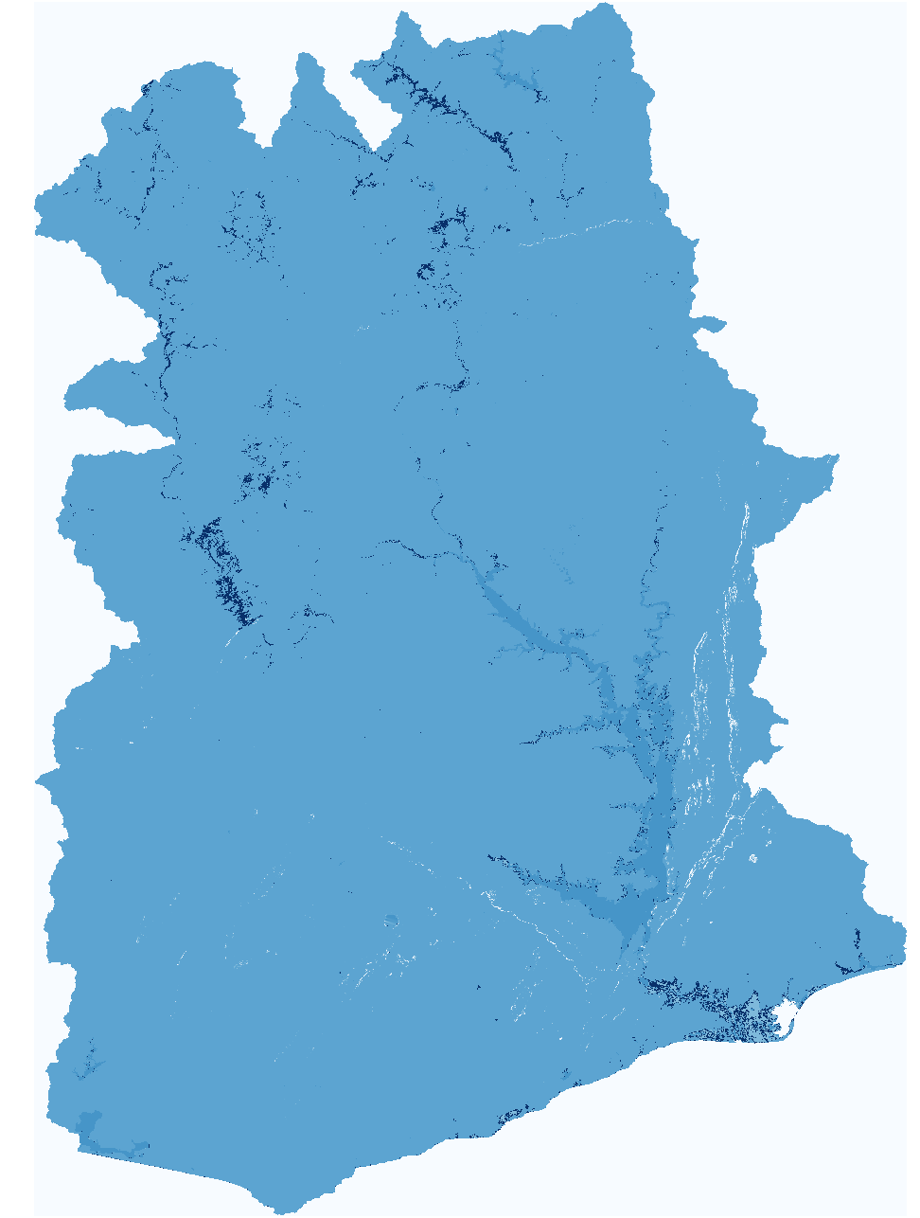
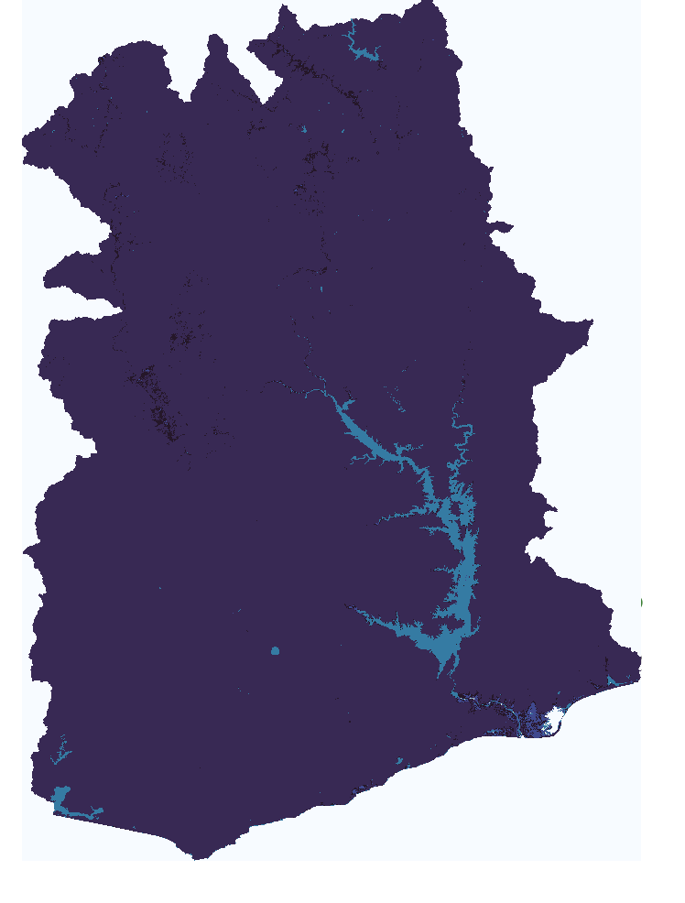
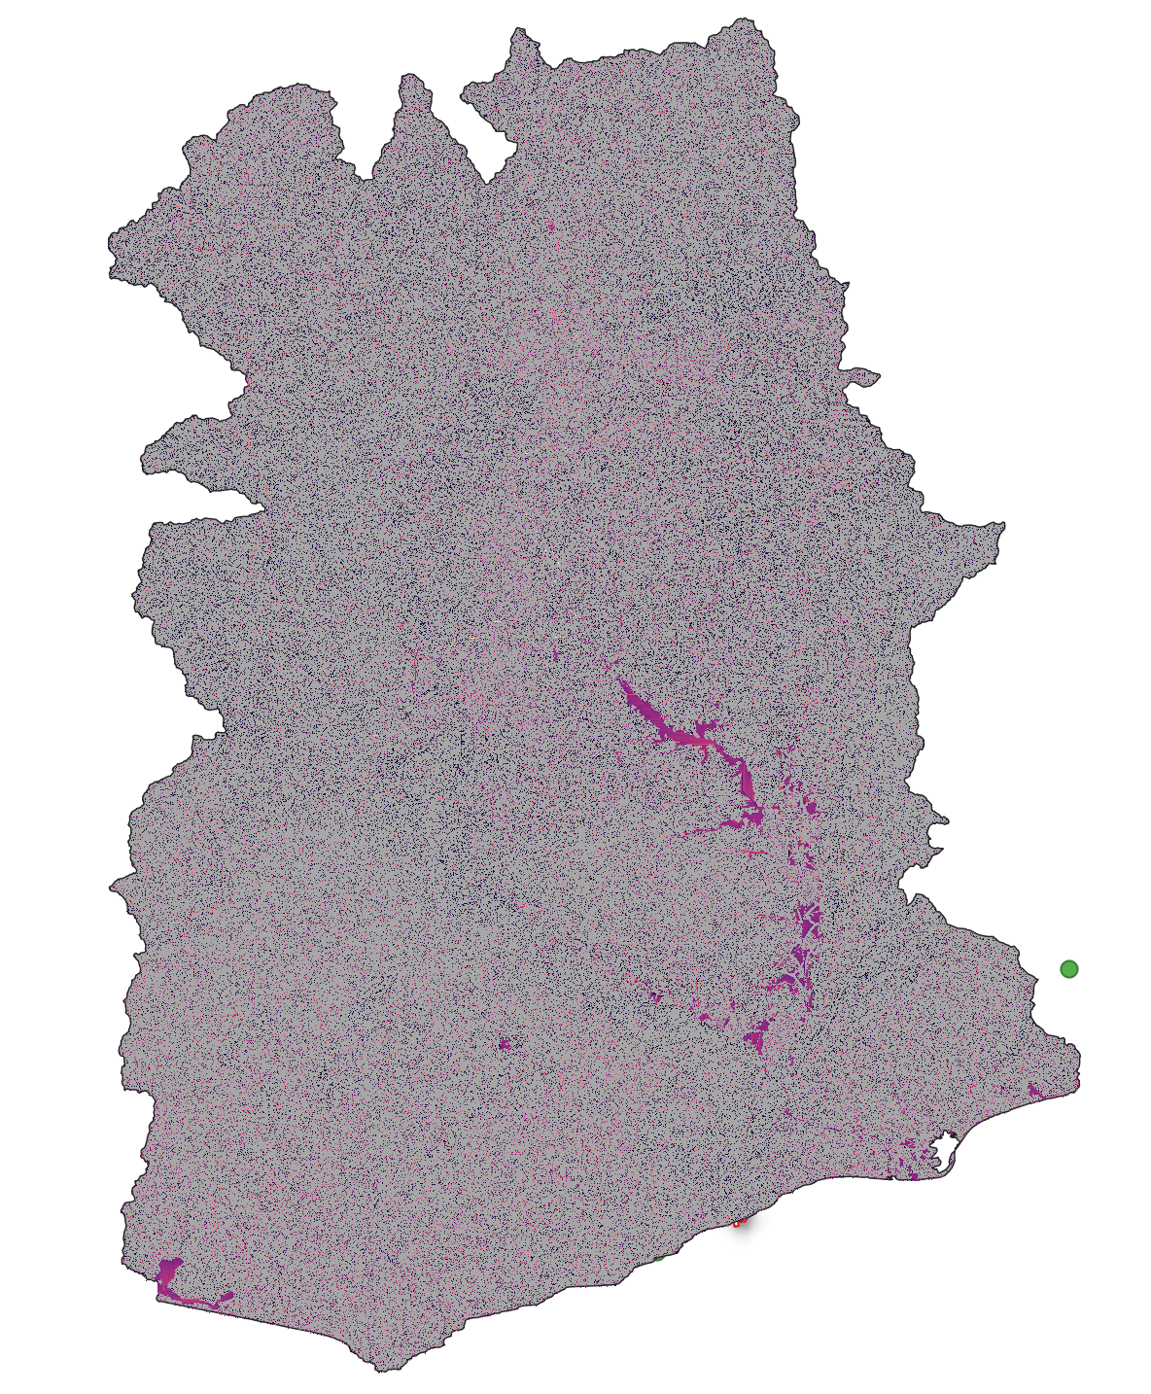
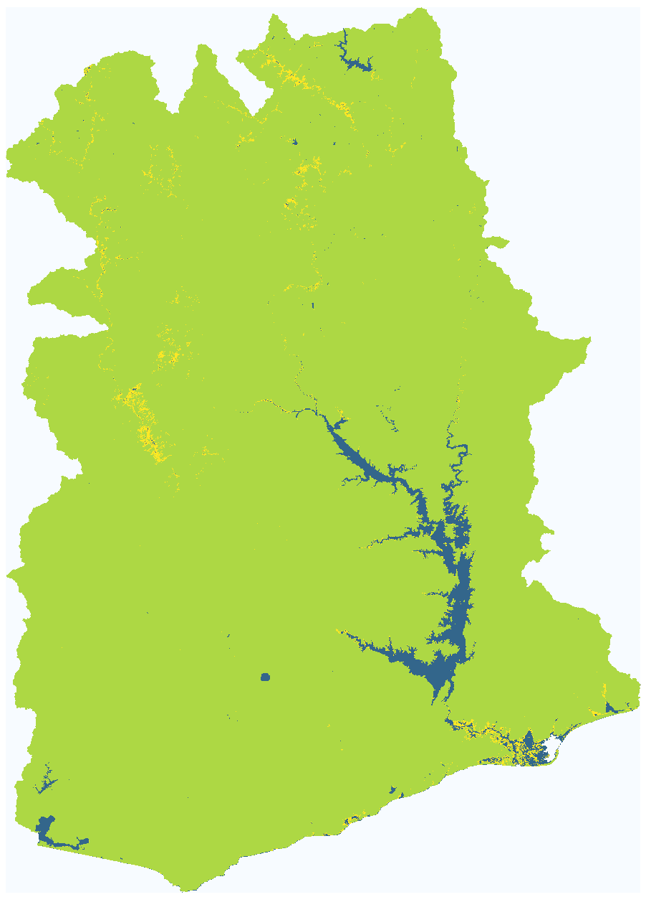
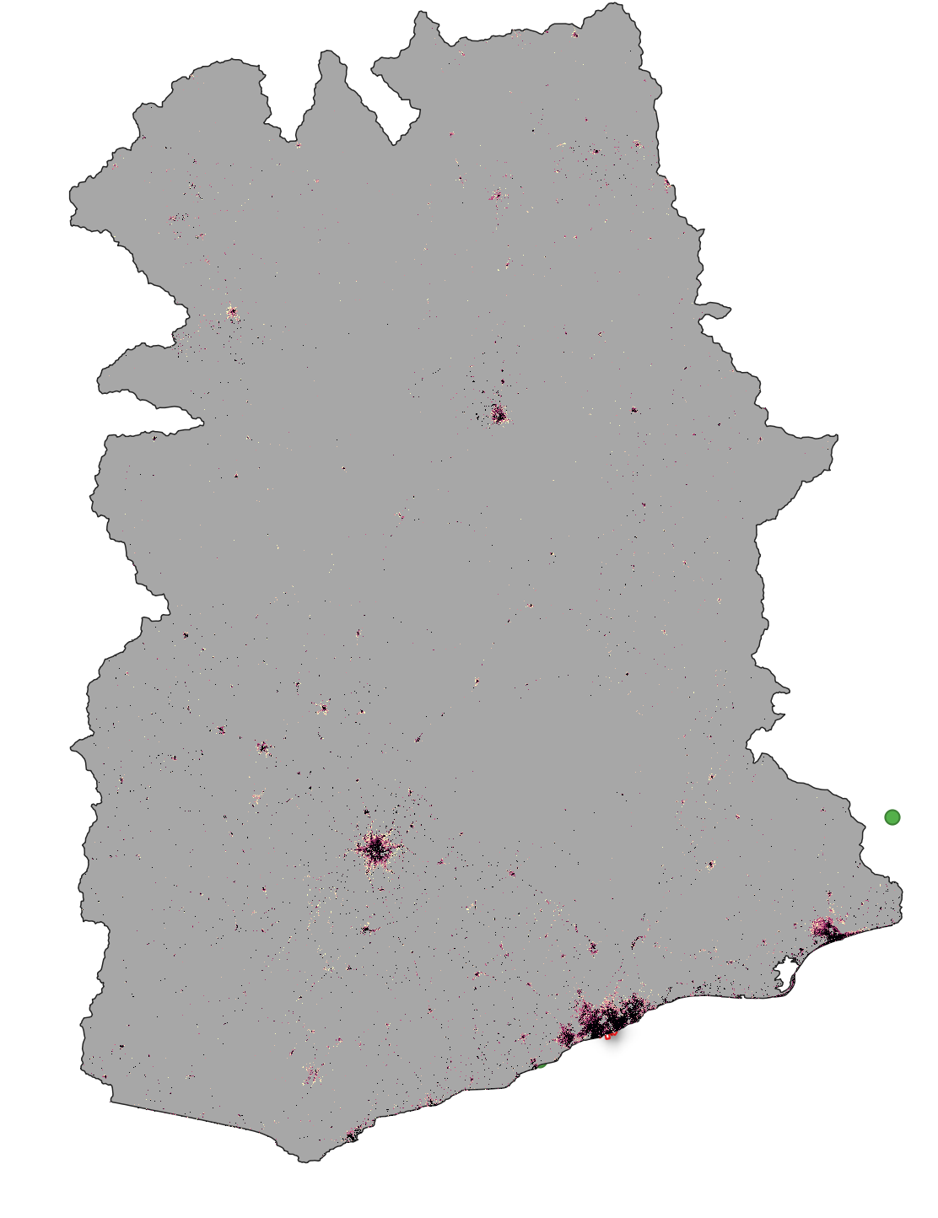
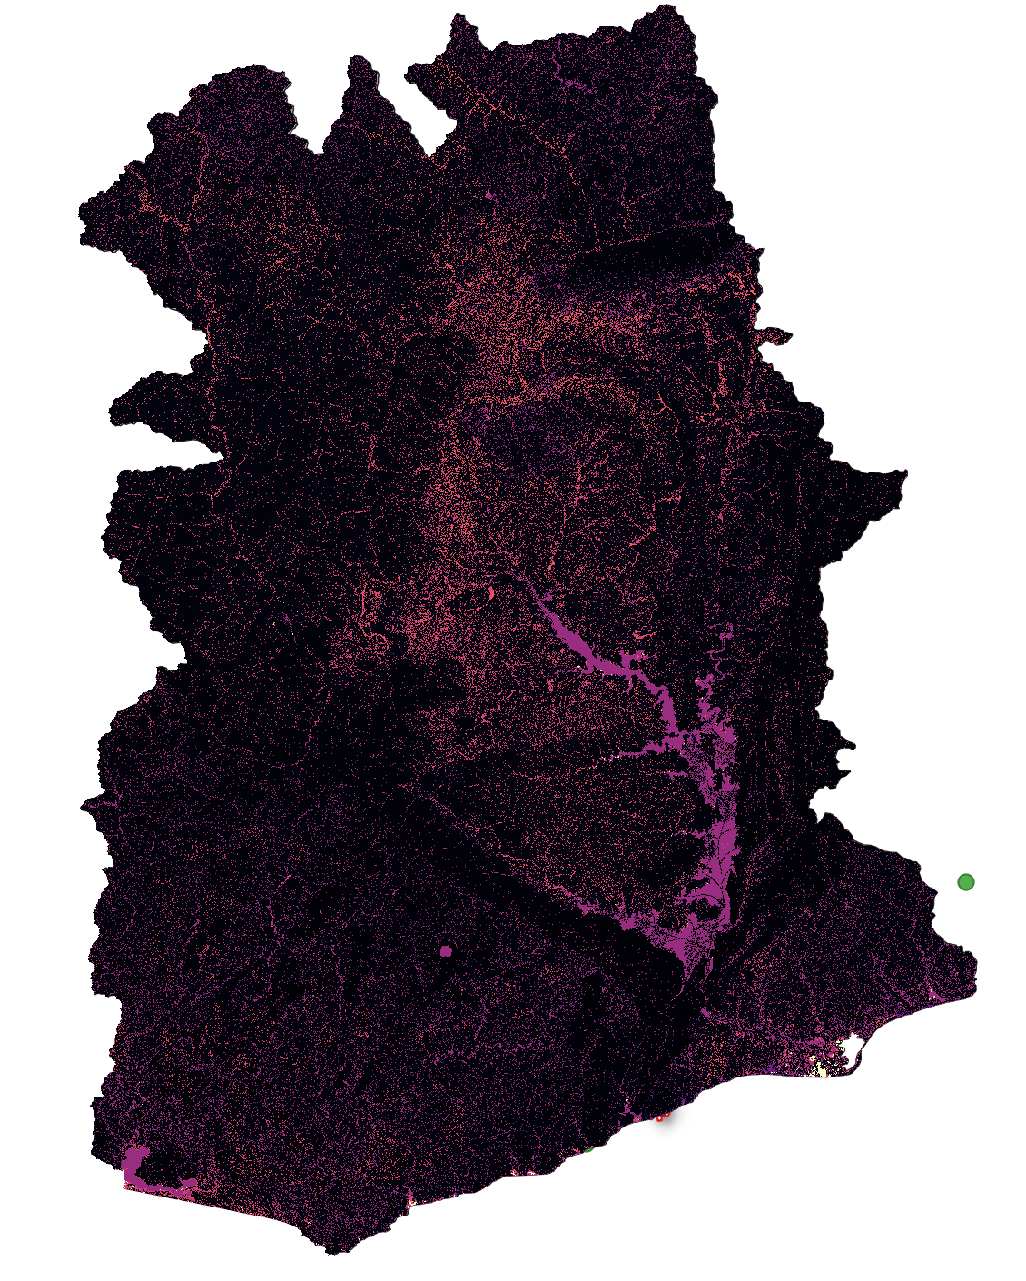
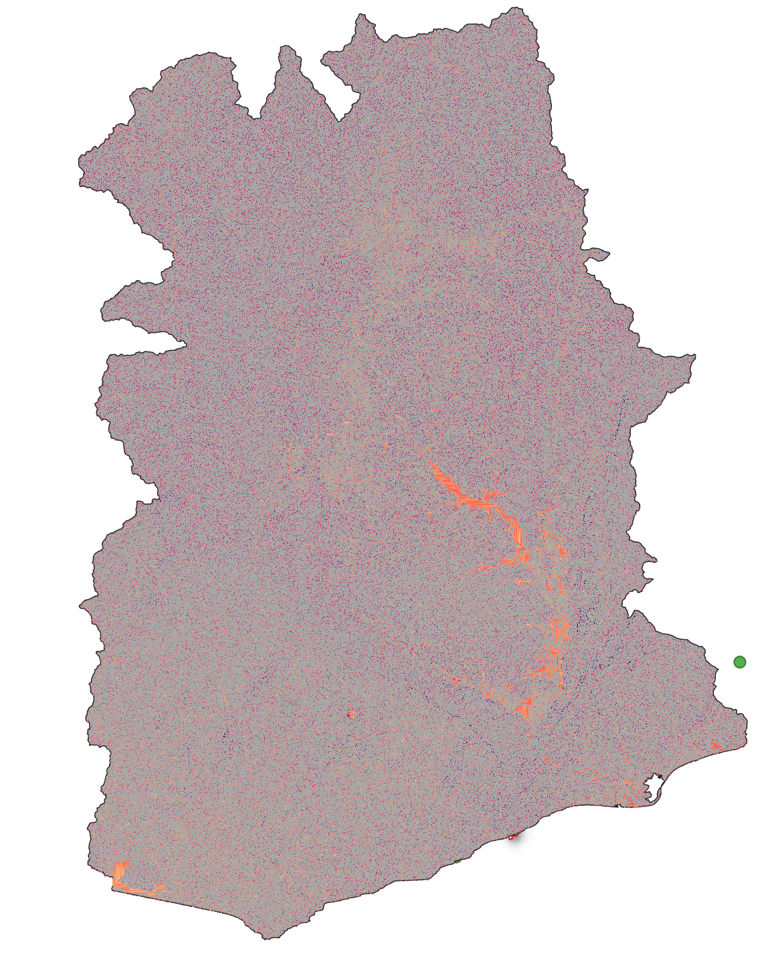
Finalize configuration for high-resolution (90m) model for Ghana
We finished the domain configuration:
Prepare domain grids at 90m resolution
Identify and correct 'bad' pixels in our files.
Download new impervious surface data (90m).
Estimate minimum area for channel network definition.
Test the configuration for the Ghana event.
wm
ksat
alpha
b
im
alpha0
beta

Slide 3
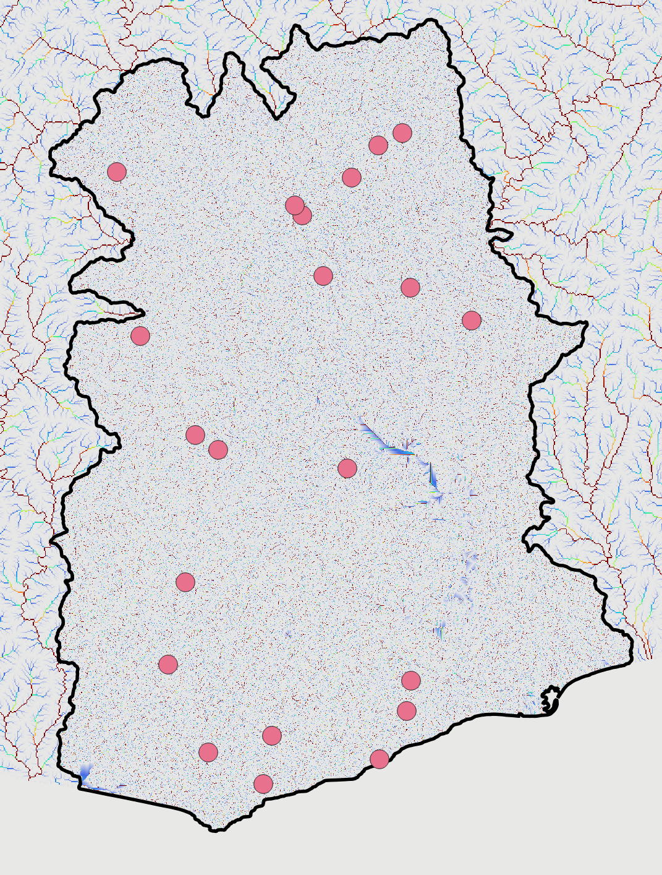
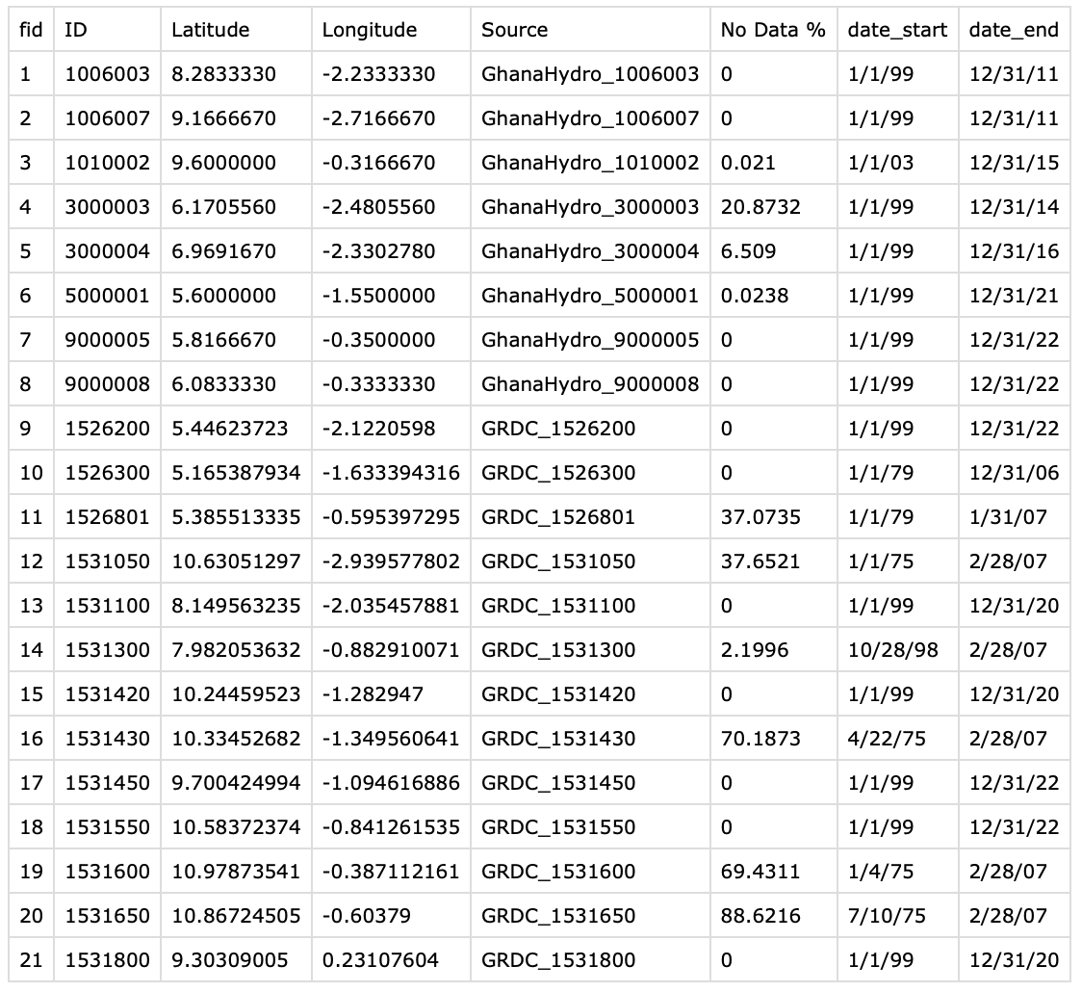
Next: Start the calibration process for the Ghana90m model.
Stablish the baseline model.
Correction of pixel.
Data quality control.
We currently have 21 stations.

Slide 4
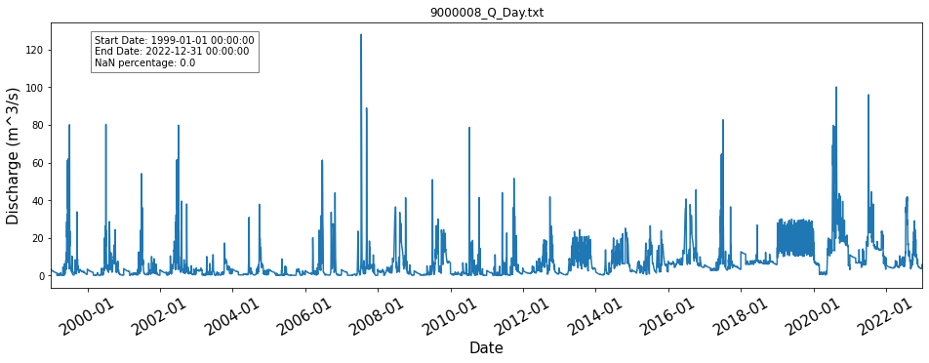
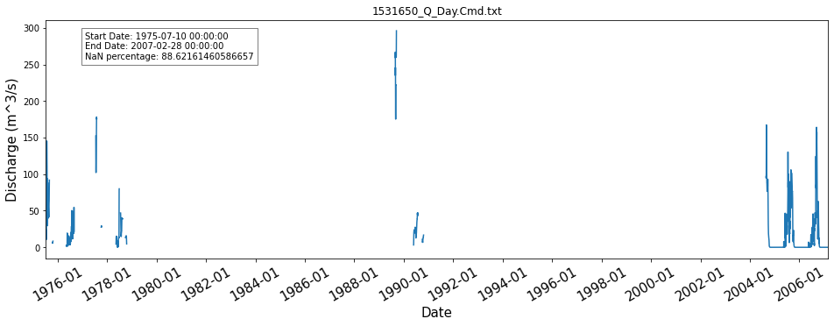
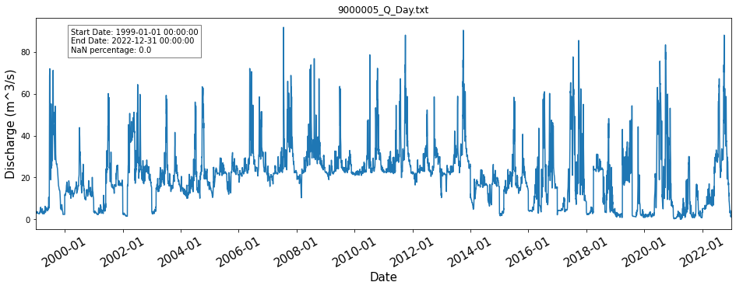

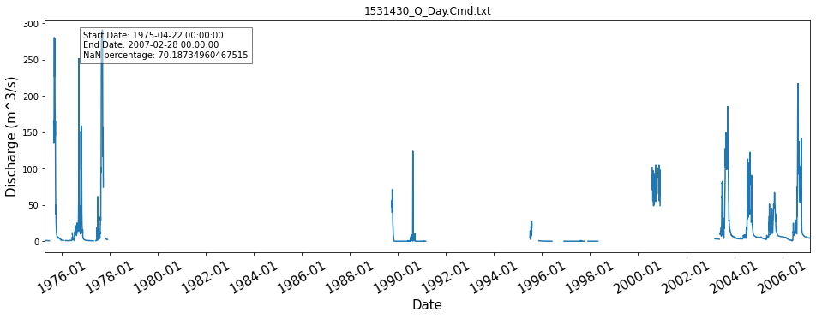
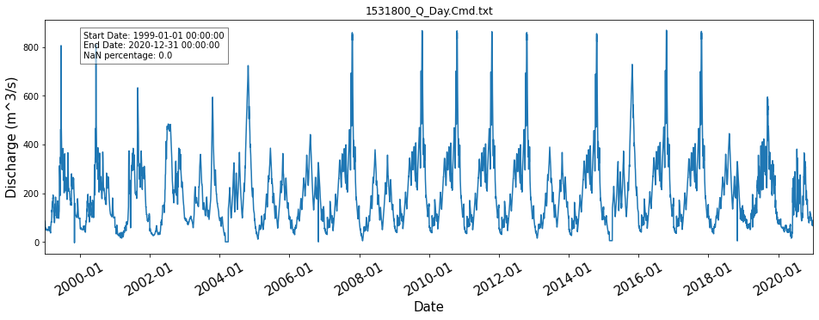
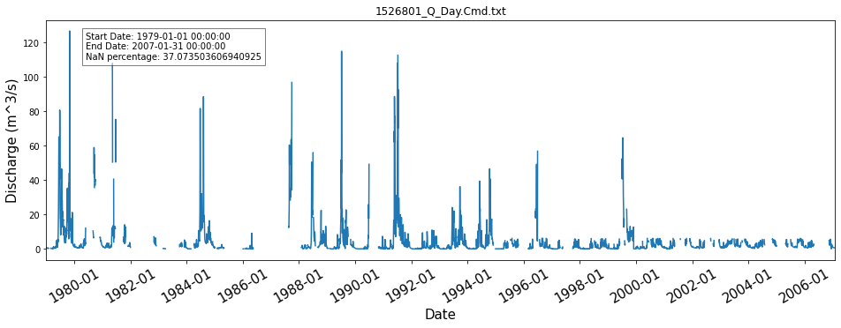

Slide 5
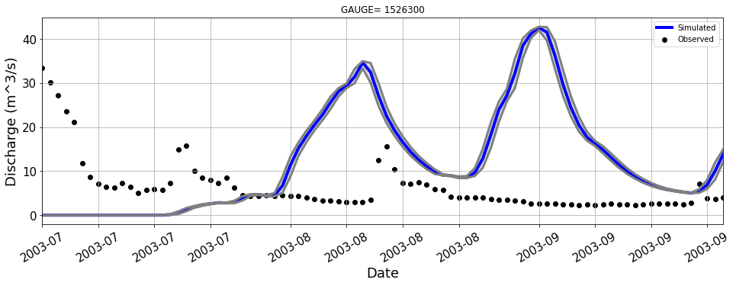
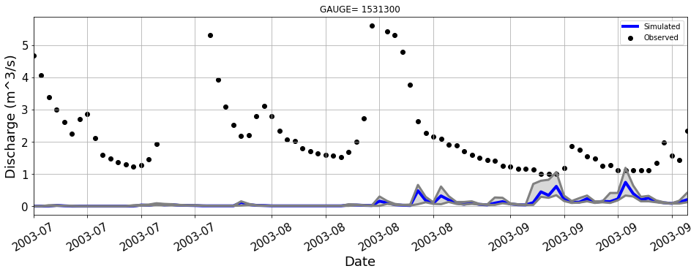
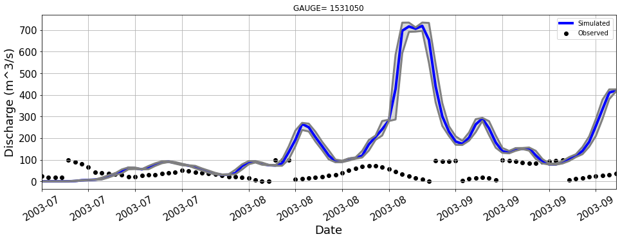
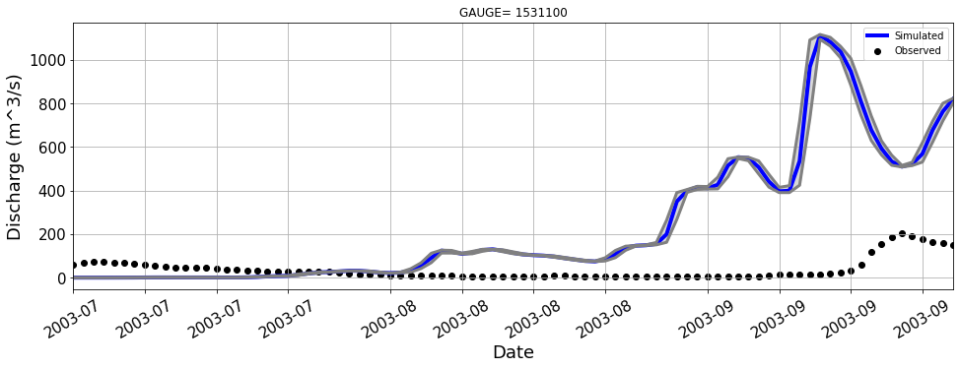
Stablish the baseline model.
Run model: warmup (1 year) + (1 year) simulations.

Slide 6
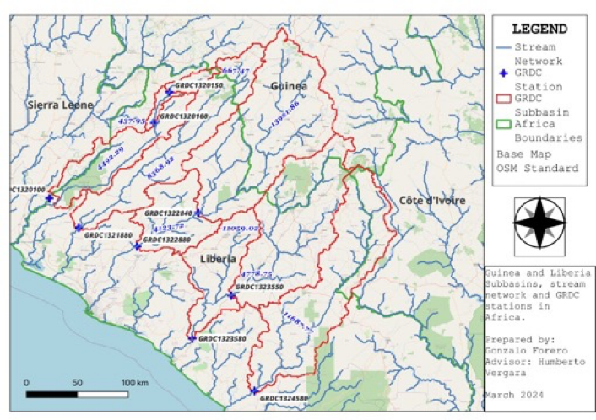
West Africa Model Evaluation
Calibration continues
Revisions were needed
Rainfall units (IMERG Early vs Final)
Nested gauges
Manual calibration
Season-focused
Individual basins
Evaluation strategy is being refined
Identify useful metrics from daily values
Use current calibration runs, then update

Slide 7
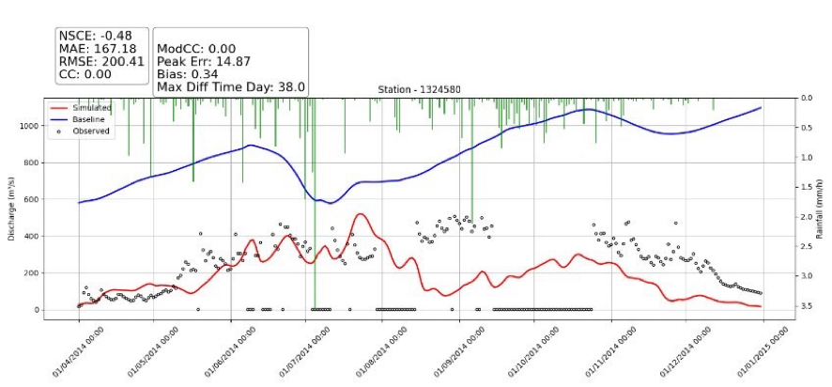
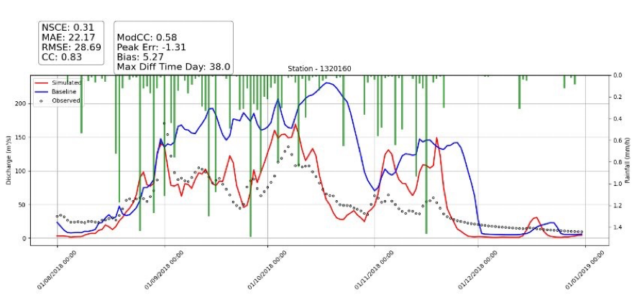
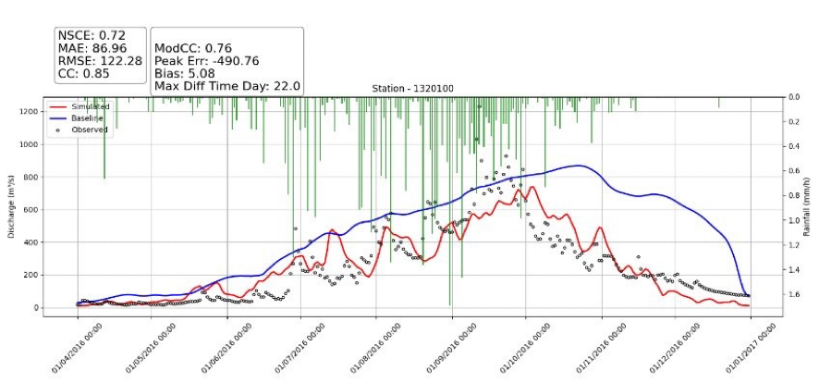
West Africa Model Evaluation

Slide 8
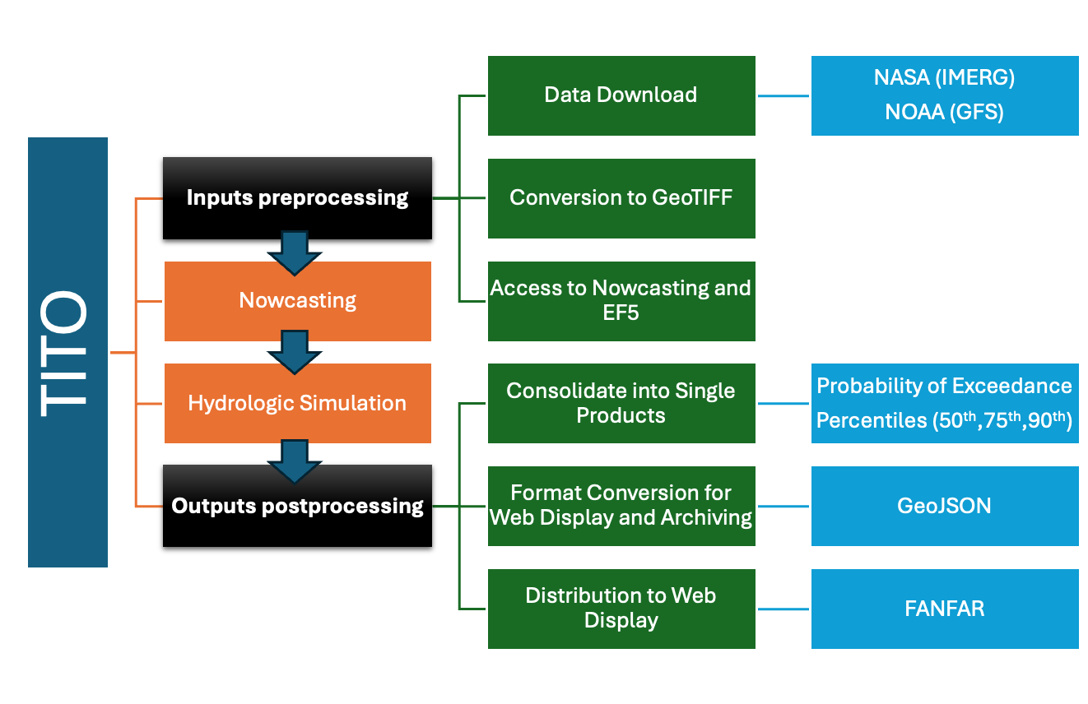
Threading Inputs To Outputs (TITO)
Progress
Requirements have been compiled into a "portable list"
Test complete in Rutgers
Download IMERG Early routine added to TITO
Ongoing
Testing in Iowa
Next
Extracting EF5 routines outside current version of TITO
Review and revise TITO routines

